Slide 1
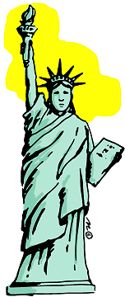
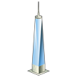
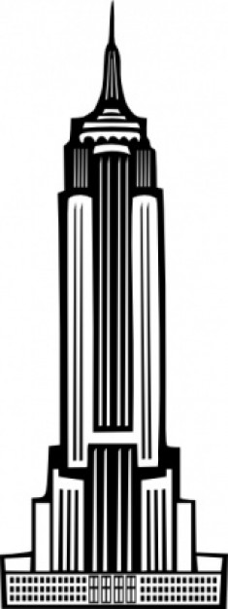
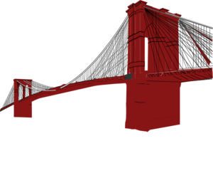
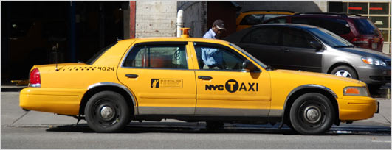
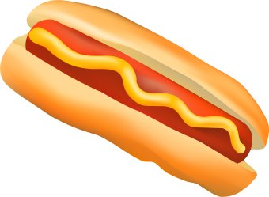
Let’s go to …
New York city!

Slide 2
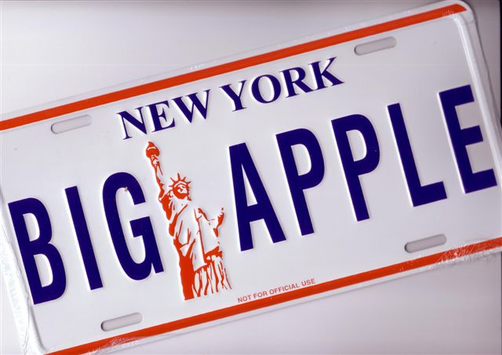
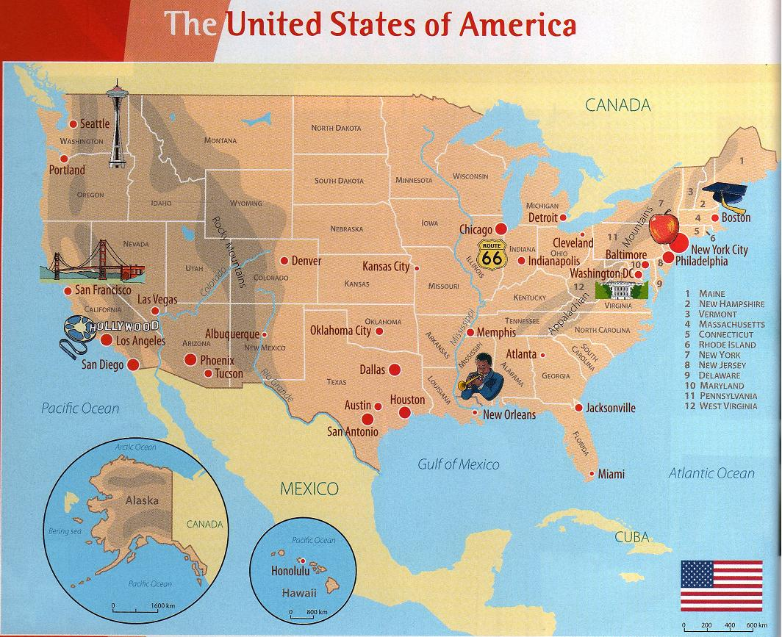
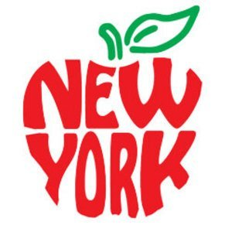
The name was first used by a sports journalist in the 1920s.
In the 1970s the city began to use its nickname in their advertising campaigns to attract tourists.
New York City is called
« The Big Apple »

Slide 3
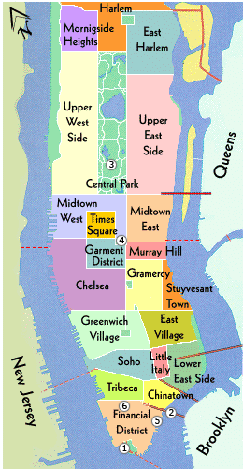
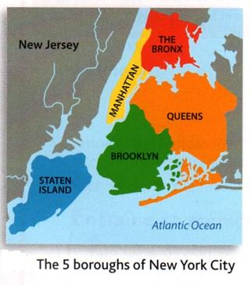
The city has
a population of more than 8 million people.
It’s the most populated city in the USA
The city is made up of five boroughs
(or districts)
43.8 billion tourists per year!
The most famous is Manhattan

Slide 4
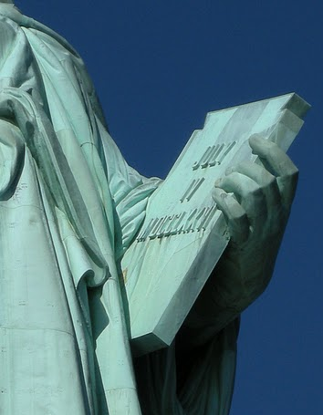
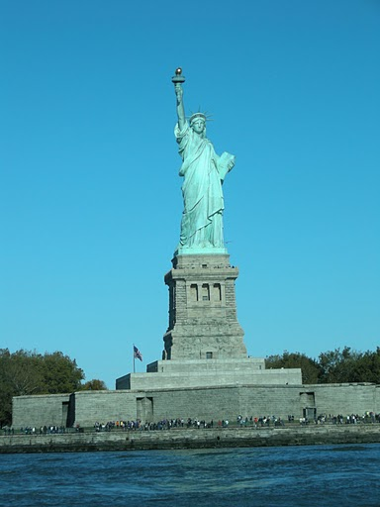
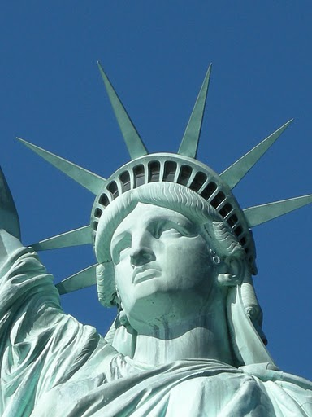
The statue of liberty
The seven spikes
on Liberty’s crown represent
the seven seas and the seven continents.
The tablet in the statue’s hand shows an important date:
July 4, 1776 ,
Day of the declaration of independence
The statue is a universal symbol of freedom and democracy. It was a gift from France in 1886.

Slide 5
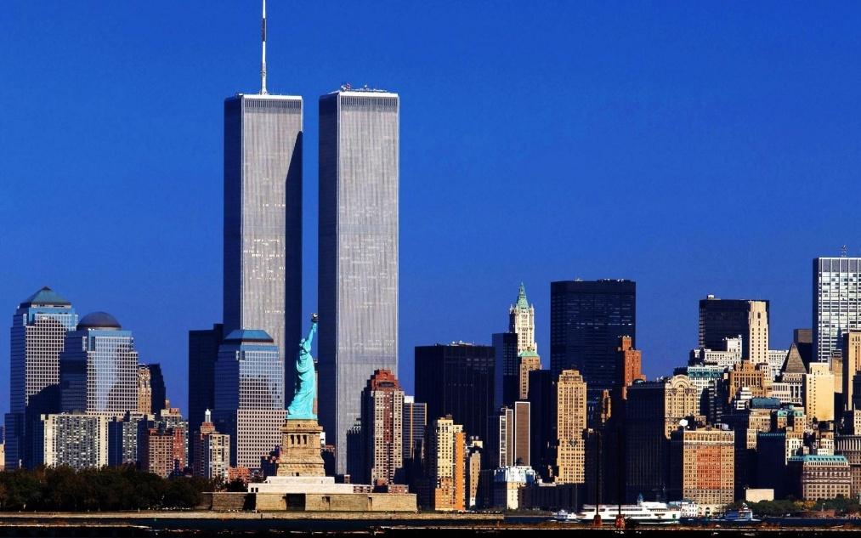
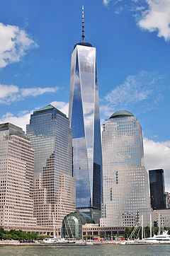
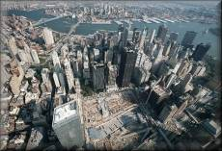
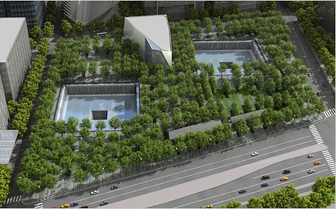
GROUND ZERO AND ONE WORLD TRADE CENTER
On September 11,2001 terrorists crashed two airplanes into the Twin towers of the WTC, killing 2750 people.
Today, Ground Zero is a memorial for the victims
A new tower has been built, One World Trade Center
(also called The Freedom Tower) It’s 541m high.It’s the tallest tower in NYC.

Slide 6
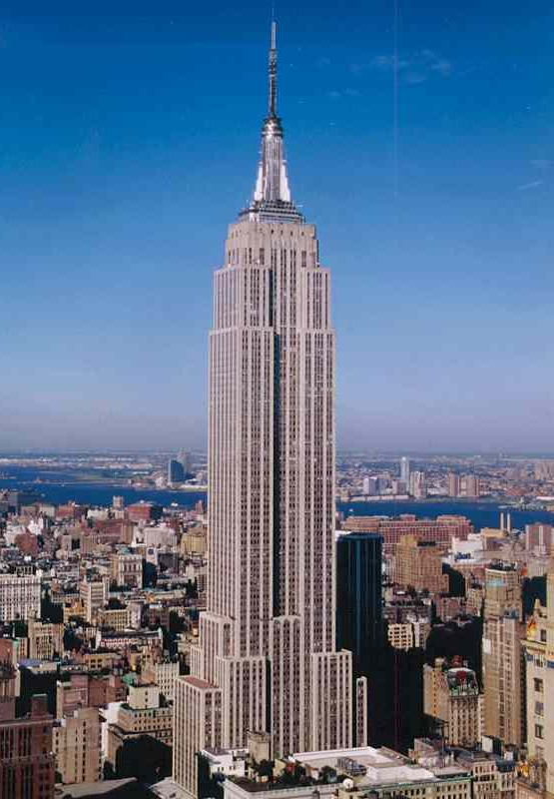
The EMPIRE STATE BUILDING
443 metres
The Empire State building
is a 102-story skyscraper.
It’s 381 metres high,
or 443 metres high with its antenna.
There are 6,500 windows!
381 metres
The Empire state building was completed in 1931.
It took 410 days to build. It was the tallest skyscraper in NYC until the construction of the Twin Towers in 1972. It became the tallest again from September 2001 to 2013
20,000 people work in this buiding!
There are 1,680 steps, 73 elevators
And no 13th floor!

